Slide 1
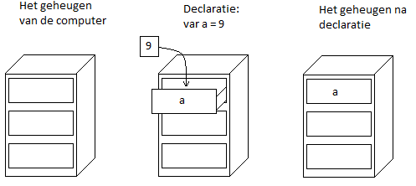

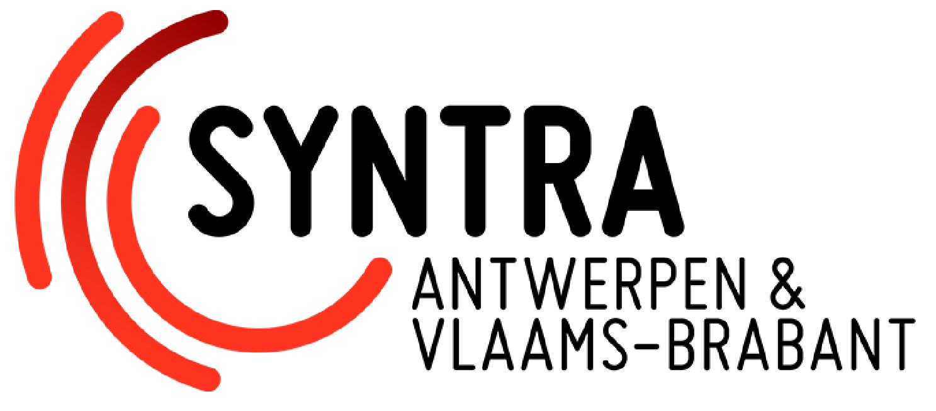
Variables
Een variable is een manier om data op te slaan in het geheugen van je computer.
Variabelen worden gebruikt om gegevens te representeren, zoals getallen, tekst, of objecten.
Bvb.
int a = 5;
int b = 4;
int d = 6, e =7, f = 8;
string text = "een tekst";

Slide 2
Variable types
int normal_number = 15654; // gehele getallen: -2,147,483,648 to 2,147,483,647
long large_number = 10458122366; //grote gehele getallen: -9,223,372,036,854,775,808 to 9,223,372,036,854,775,807
bool truth_value = true; //binaire waarde: true or false
float decimal_number = 15.5f;//getallen met decimalen: ±1.5 x 10−45 to ±3.4 x 1038. PRECISION: ~6-9 digits
double large_dec_num = 15.5d;//grote getallen met decimalen: ±5.0 × 10−324 to ±1.7 × 10308 PRECISION: ~15-17 digits
char character = 's'; //enkel karakter
string text = "een text"; //sequentie van karakters
//inferred types: de compiler (deel van de engine die uw code interpreteert) kan vaak achterhalen welk type het is.
var text = "een tekst"; // C# zelfde als string text
auto number_integer = 123; // C++ zelfde als int number_integer
//collecties: een set van waardes van hetzelfde data type in 1 variabele
int [] array = { 9, 6, 7, 2}; // 0-based
// int[0] --> 1
// int[1] --> 9
// int[2] --> 7
// int[3] --> 2
// int[4] ==> FOUT want de array is maar 4 groot
Notes:
Not all languages have types, those that do are considered type-safe. Those without can become dicey at times
https://www.w3schools.com/cs/exercise.php?filename=exercise_variables1
https://www.w3schools.com/cs/exercise.php?filename=exercise_data_types1 // => all except 4. Casting explain live

Slide 3
Operators
// getallen
// + voor optellen
// - voor aftrekken
// * voor vermenigvulidgen
// / voor delen
// % voor module (rest van een deling)
int a = 5 + 2; //a = 7
//met variabelen
int b = 3;
int c = 6;
int d = b + c; // d = 9
// text(string/char)
// + voor aaneenschakelen
string text = "kerst" + "mis"; //text = kerstmis
// booleans
bool isEquals = (9 == 10);
bool isSmaller = (9 <= 10);
bool notEquals = (9 != 10);
bool combiningWithAnd = notEquals && isSmaller;
bool combiningWithOr = notEquals || isSmaller;
Notes:
Not all languages have types, those that do are considered type-safe. Those without can become dicey at times
Explain += and ++ live
https://www.w3schools.com/cs/exercise.php?filename=exercise_operators1
https://www.w3schools.com/cs/exercise.php?filename=exercise_strings1 ➔ just 1 and 2
https://www.w3schools.com/cs/exercise.php?filename=exercise_booleans1

Slide 4
Control Flow
// if-else statements
int a = 2;
bool isTwo;
if(a == 2) // == voor "zijn links en rechts gelijk"
{
isTwo = true;
} else {
isTwo = false;
}
// loops: for and while
int b = 0;
while(b < 5)
{
b = b + 1; //as we go through the loop, b becomes 1, then 2 , etc. Loop stops when b >= 5
}
for(i = 0; i < 5;i++)
{
//as we go through the loop, a becomes 1, then 2 , etc. Loop stops when b >= 5 }

Slide 5
Control Flow
//else if
if(a == 2) {
} else if(a == 3) {
} else {
}
//shortened notation
string value = (a != 10) ? "not ten" : "ten";
switch(a)
{
case 1:
Console.WriteLine("Is 1");
break;
case 2:
Console.WriteLine("Is 2");
break;
default:
Console.WriteLine("Is not 1 and not 2");
break;
}

Slide 6
Control Flow
//do -while
int i = 0;
do
{
Console.WriteLine("i = {0}", i);
i++; } while (i < 5); //stop the loop early
for (int i = 10; i < 20; i++)
{
if(i == 15)
{
break;
}
} //skip to the next step
for (int i = 10; i < 20; i++)
{
if(i == 15)
{
continue;
} Console.WriteLine("Is " + i);
}
Notes:
https://www.w3schools.com/cs/exercise.php?filename=exercise_conditions1
https://www.w3schools.com/cs/exercise.php?filename=exercise_switch1
https://www.w3schools.com/cs/exercise.php?filename=exercise_while_loop1
https://www.w3schools.com/cs/exercise.php?filename=exercise_arrays1 ➔ try and we will do together if wont work

Slide 7
Functions/Methods
int a = 3;
int b = 4;
int c = 1
Function(); // --> calling the function
public void Function()
{
c = a + b; // c becomes 7
c = c - 3; // c becomes 4
c = c / 2; // c becomes 2
}

Slide 8
Functions
int a = 3;
int b = 4;
int c = 1
FunctionWithParameter(b); // --> calling the function
FunctionWithParameter(4); // --> Identical
public void FunctionWithParameter(int parameter)
{
c = a + parameter; // c becomes 7
c = c - parameter; // c becomes 4
c = c / 2; // c becomes 2
}
Notes:
Not all languages have types, those that do are considered type-safe. Those without can become dicey at times

Slide 9
Functions
int a = 3;
int b = 4;
int c = FunctionWithParametersAndReturnValue(a, b); // --> calling the function and setting c to it's return values=
public int FunctionWithParametersAndReturnValue(int parameter1, int parameter2)
{
int temp = parameter1 + parameter2; // temp becomes 7
temp = temp - parameter1; // temp becomes 4
temp = temp / 2; // temp becomes 2
return temp; // returns 2
}
OR
public int FunctionWithParametersAndReturnValue(int parameter1, int parameter2)
{
return ((parameter1 + parameter2) - parameter1) / 2;
}
Notes:
https://www.w3schools.com/cs/exercise.php?filename=exercise_methods4

